Slide 1
BIOS27815: Infectious Diseases
Introduction to Vector-Borne Diseases
UChicago Center in Paris
Paris, France
January 2025

Slide 2
Mechanisms of disease transmission
Directly-transmitted diseases – transmitted via exchange of bodily fluids
Droplet (> 5 microns ) spread or direct contact, includes sexually-transmitted pathogens
Ex: Smallpox (Variola spp.), HIV, Mononucleosis (Epstein Barr virus)
Indirectly-transmitted diseases – transmitted via droplets retained in air
Droplets < 5 microns in diameter
Ex: Measles, COVID (SARS-CoV-2)
Vertically-transmitted pathogens – transmitted mother-to-child in utero
Ex: HIV, Herpes simplex virus, Cytomegalovirus, Rubella, Zika
Environmentally-transmitted pathogens – transmitted outside host (e.g. water, food)
Ex: Cholera (Vibrio cholerae), Salmonellosis (Salmonella spp. bacteria)
Vector-borne diseases (a type of indirect transmission) are transmitted via blood-feeding arthropod (mosquitoes, ticks, fleas)
Ex: malaria, arboviruses (dengue, yellow fever), sleeping sickness, plague

Slide 3
Mechanisms of disease transmission
Directly-transmitted diseases – transmitted via exchange of bodily fluids
Droplet (> 5 microns ) spread or direct contact, includes sexually-transmitted pathogens
Ex: Smallpox (Variola spp.), HIV, Mononucleosis (Epstein Barr virus)
Indirectly-transmitted diseases – transmitted via droplets retained in air
Droplets < 5 microns in diameter
Ex: Measles, COVID (SARS-CoV-2)
Vertically-transmitted pathogens – transmitted mother-to-child in utero
Ex: HIV, Herpes simplex virus, Cytomegalovirus, Rubella, Zika
Environmentally-transmitted pathogens – transmitted outside host (e.g. water, food)
Ex: Cholera (Vibrio cholerae), Salmonellosis (Salmonella spp. bacteria)
Vector-borne diseases (a type of indirect transmission) are transmitted via blood-feeding arthropod (mosquitoes, ticks, fleas)
Ex: malaria, arboviruses (dengue, yellow fever), sleeping sickness, plague

Slide 4
Mechanisms of disease transmission
Directly-transmitted diseases – transmitted via exchange of bodily fluids
Droplet (> 5 microns ) spread or direct contact, includes sexually-transmitted pathogens
Ex: Smallpox (Variola spp.), HIV, Mononucleosis (Epstein Barr virus)
Indirectly-transmitted diseases – transmitted via droplets retained in air
Droplets < 5 microns in diameter
Ex: Measles, COVID (SARS-CoV-2)
Vertically-transmitted pathogens – transmitted mother-to-child in utero
Ex: HIV, Herpes simplex virus, Cytomegalovirus, Rubella, Zika
Environmentally-transmitted pathogens – transmitted outside host (e.g. water, food)
Ex: Cholera (Vibrio cholerae), Salmonellosis (Salmonella spp. bacteria)
Vector-borne diseases (a type of indirect transmission) are transmitted via blood-feeding arthropod (mosquitoes, ticks, fleas)
Ex: malaria, arboviruses (dengue, yellow fever), sleeping sickness, plague

Slide 5
Mechanisms of disease transmission
Directly-transmitted diseases – transmitted via exchange of bodily fluids
Droplet (> 5 microns ) spread or direct contact, includes sexually-transmitted pathogens
Ex: Smallpox (Variola spp.), HIV, Mononucleosis (Epstein Barr virus)
Indirectly-transmitted diseases – transmitted via droplets retained in air
Droplets < 5 microns in diameter
Ex: Measles, COVID (SARS-CoV-2)
Vertically-transmitted pathogens – transmitted mother-to-child in utero
Ex: HIV, Herpes simplex virus, Cytomegalovirus, Rubella, Zika
Environmentally-transmitted pathogens – transmitted outside host (e.g. water, food)
Ex: Cholera (Vibrio cholerae), Salmonellosis (Salmonella spp. bacteria)
Vector-borne diseases (a type of indirect transmission) are transmitted via blood-feeding arthropod (mosquitoes, ticks, fleas)
Ex: malaria, arboviruses (dengue, yellow fever), sleeping sickness, plague

Slide 6
Mechanisms of disease transmission
Directly-transmitted diseases – transmitted via exchange of bodily fluids
Droplet (> 5 microns ) spread or direct contact, includes sexually-transmitted pathogens
Ex: Smallpox (Variola spp.), HIV, Mononucleosis (Epstein Barr virus)
Indirectly-transmitted diseases – transmitted via droplets retained in air
Droplets < 5 microns in diameter
Ex: Measles, COVID (SARS-CoV-2)
Vertically-transmitted pathogens – transmitted mother-to-child in utero
Ex: HIV, Herpes simplex virus, Cytomegalovirus, Rubella, Zika
Environmentally-transmitted pathogens – transmitted outside host (e.g. water, food)
Ex: Cholera (Vibrio cholerae), Salmonellosis (Salmonella spp. bacteria)
Vector-borne diseases (a type of indirect transmission) are transmitted via blood-feeding arthropod (mosquitoes, ticks, fleas)
Ex: malaria, arboviruses (dengue, yellow fever), sleeping sickness, plague

Slide 7
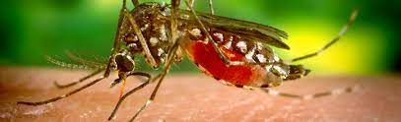
Pathogens exhibit diverse transmission mechanisms that require tailored modeling structures
Vector-borne diseases (a type of indirect transmission) are transmitted via blood-feeding arthropod (mosquitoes, ticks, fleas)
Euclidean vector: a quantity with a magnitude and direction
Epidemiological vector: an agent that carries and transmits an infectious patient into another living organism
Notes:
Kissing bugs = hemiptera = true bugs

Slide 8
Pathogens exhibit diverse transmission mechanisms that require tailored modeling structures
Vector-borne diseases (a type of indirect transmission) are transmitted via blood-feeding arthropod (mosquitoes, ticks, fleas)
Malaria: Mosquito-borne protozoan Plasmodium spp.
“Arboviruses”: Mosquito-borne viruses, including Dengue, Zika, Yellow fever virus, West Nile virus, Chikungunya virus
Sleeping sickness, also known as African trypanosomiasis: tsetse fly vector and protozoan pathogen (trypanosome)
Chagas disease: kissing bug vector and trypanosome pathogen
Plague: flea vector and bacterial pathogen (Yersinia pestis)
Notes:
Kissing bugs = hemiptera = true bugs

Slide 9
Pathogens exhibit diverse transmission mechanisms that require tailored modeling structures
Vector-borne diseases (a type of indirect transmission) are transmitted via blood-feeding arthropod (mosquitoes, ticks, fleas)
Malaria: Mosquito-borne protozoan Plasmodium spp.
“Arboviruses”: Mosquito-borne viruses, including Dengue, Zika, Yellow fever virus, West Nile virus, Chikungunya virus
Sleeping sickness, also known as African trypanosomiasis: tsetse fly vector and protozoan pathogen (trypanosome)
Chagas disease: kissing bug vector and trypanosome pathogen
Plague: flea vector and bacterial pathogen (Yersinia pestis)
Notes:
Kissing bugs = hemiptera = true bugs

Slide 10
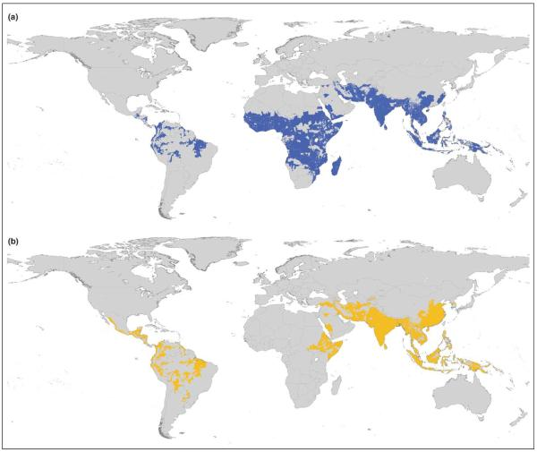
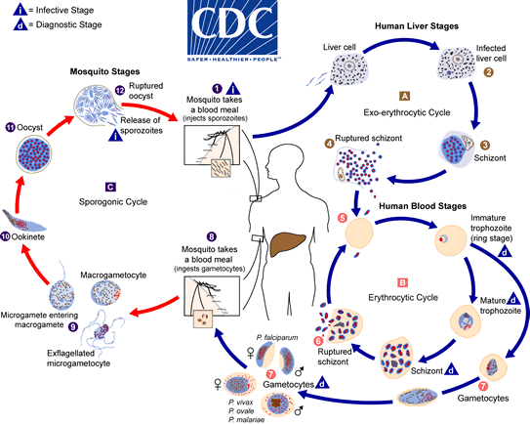
Malaria
4 main human Plasmodium parasites (falciparum, vivax, malariae, ovalae).
Over 200 Plasmodium spp. globally, infecting birds, reptiles, and other mammals (rodents, bats, primates)
Distribution Plasmodium falciparum
Distribution Plasmodium vivax
Guerra et al. 2006. Trends in Parasitology

Slide 11
Malaria
4 main human Plasmodium parasites (falciparum, vivax, malariae, ovalae).
Over 200 Plasmodium spp. globally, infecting birds, reptiles, and other mammals (rodents, bats, primates)
Distribution Plasmodium falciparum
Distribution Plasmodium vivax
Plasmodium parasites time RBC bursting such that they are at peak blood stage circulation when mosquito vectors are feeding at dusk!
Guerra et al. 2006. Trends in Parasitology

Slide 12
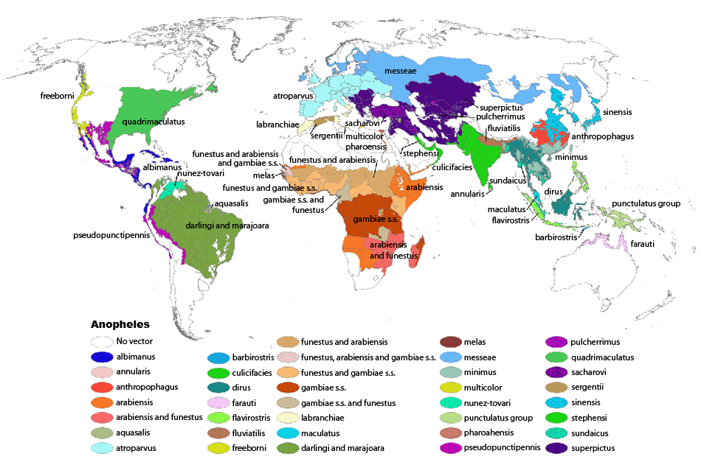
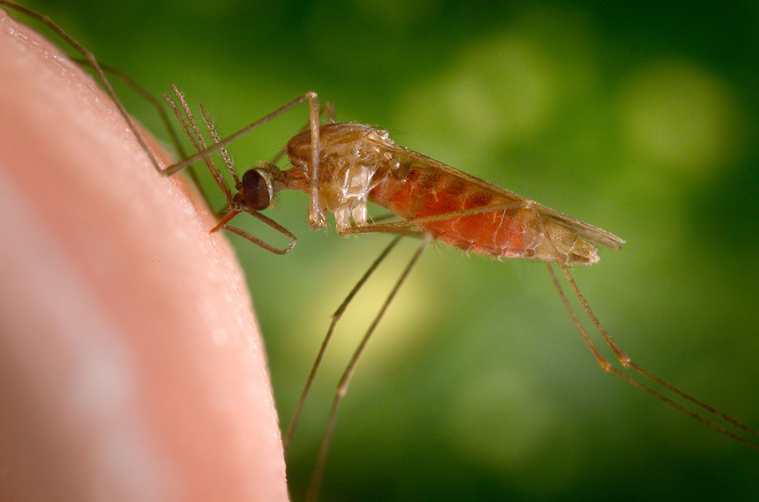
Malaria
4 main human Plasmodium parasites (falciparum, vivax, malariae, ovalae).
Over 200 Plasmodium spp. globally, infecting birds, reptiles, and other mammals (rodents, bats, primates)
>400 global species of Anopheles mosquito, >100 that can transmit human malaria
~30-40 Anopheles spp. most commonly implicated in human malaria transmission!
Kiszewksi et al. 2004. ASTMH.

Slide 13
Malaria
4 main human Plasmodium parasites (falciparum, vivax, malariae, ovalae).
Over 200 Plasmodium spp. globally, infecting birds, reptiles, and other mammals (rodents, bats, primates)
>400 global species of Anopheles mosquito, >100 that can transmit human malaria
~30-40 Anopheles spp. most commonly implicated in human malaria transmission!
Only female mosquitoes feed on blood!
Male mosquitoes feed on plant nectar.
Kiszewksi et al. 2004. ASTMH.

Slide 14
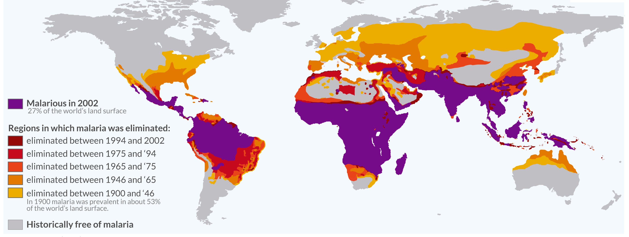
Malaria has been eliminated from many regions where it was previously endemic, including the US.
Still one of the leading causes of child mortality globally – responsible for about half a million childhood deaths a year, 80% in Africa.
OurWorldinData.org

Slide 15
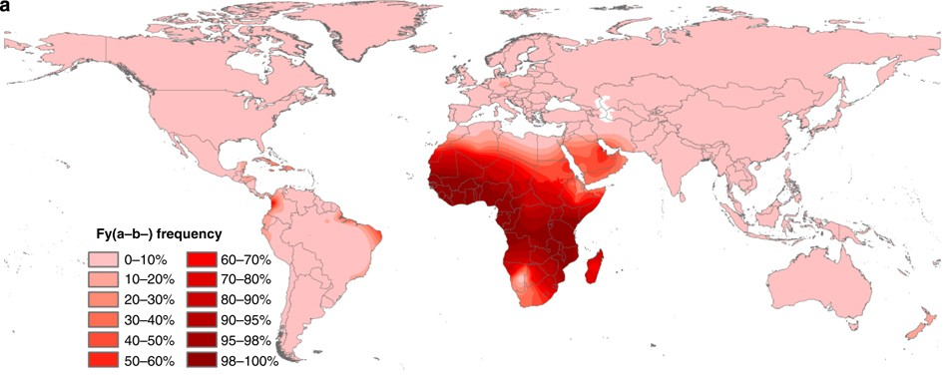
Malaria has also shaped human DNA.
Duffy antigen
Modeled distribution of Duffy-negative human population
Distribution Plasmodium falciparum
Distribution Plasmodium vivax
Guerra et al. 2006. Trends in Parasitology
Howes et al 2011. Nature Communications.

Slide 16
Challenges to malaria elimination?
High parasite diversity: sexual reproduction in 4+ Plasmodium species
Fast evolution of resistance (e.g. to drugs)
Many possible vectors! Potentially additional possible reservoirs!
Latent cases as burden is reduced
Vaccine candidates: what life stage to target?

Slide 17
Challenges to malaria elimination?
High parasite diversity: sexual reproduction in 4+ Plasmodium species
Fast evolution of resistance (e.g. to drugs)
Many possible vectors! Potentially additional possible reservoirs!
Latent cases as burden is reduced
Vaccine candidates: what life stage to target?

Slide 18
Challenges to malaria elimination?
High parasite diversity: sexual reproduction in 4+ Plasmodium species
Fast evolution of resistance (e.g. to drugs)
Many possible vectors! Potentially additional possible reservoirs!
Latent cases as burden is reduced
Vaccine candidates: what life stage to target?

Slide 19
Challenges to malaria elimination?
High parasite diversity: sexual reproduction in 4+ Plasmodium species
Fast evolution of resistance (e.g. to drugs)
Many possible vectors! Potentially additional possible reservoirs!
Latent cases as burden is reduced
Vaccine candidates: what life stage to target?

Slide 20
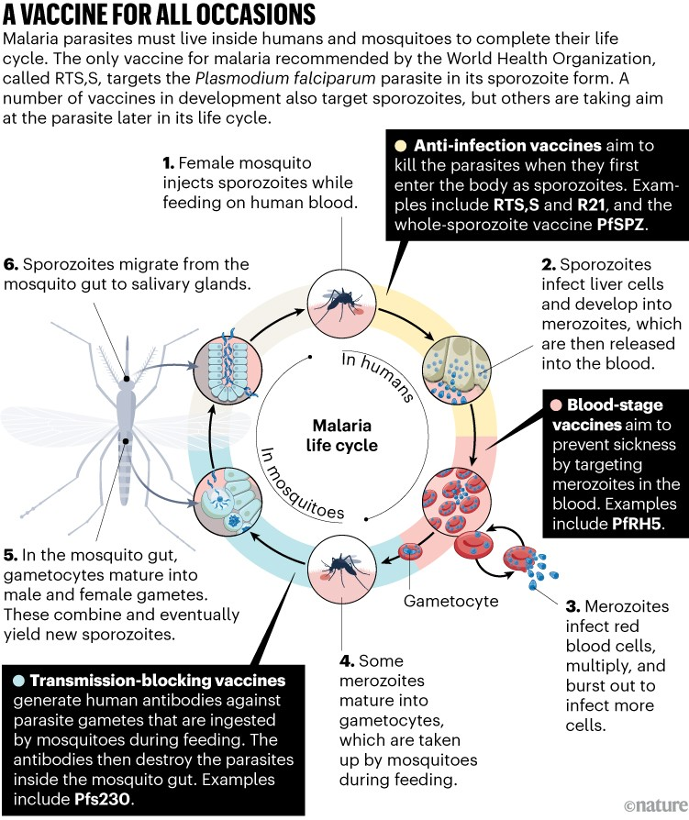
Malaria vaccines
Only two currently licensed
Mosquirix/RTS,S pre-erythrocytic vaccine licensed in 2022
Requires at least 3 doses in children <2
Does not eliminate pathogen but reduces severe malaria burden and burden of hospitalization by ~30%
R21/Matrix-M pre-erythrocytic vaccine licensed in 2023
Requires at least 3 doses in children <2
Does not eliminate pathogen but reduces severe malaria burden and burden of hospitalization by 77%

Slide 21
Pathogens exhibit diverse transmission mechanisms that require tailored modeling structures
Vector-borne diseases (a type of indirect transmission) are transmitted via blood-feeding arthropod (mosquitoes, ticks, fleas)
Malaria: Mosquito-borne protozoan Plasmodium spp.
“Arboviruses”: Mosquito-borne viruses, including Dengue, Zika, Yellow fever virus, West Nile virus, Chikungunya virus
Sleeping sickness, also known as African trypanosomiasis: tsetse fly vector and protozoan pathogen (trypanosome)
Chagas disease: kissing bug vector and trypanosome pathogen
Plague: flea vector and bacterial pathogen (Yersinia pestis)
Notes:
Kissing bugs = hemiptera = true bugs

Slide 22
Pathogens exhibit diverse transmission mechanisms that require tailored modeling structures
Vector-borne diseases (a type of indirect transmission) are transmitted via blood-feeding arthropod (mosquitoes, ticks, fleas)
Malaria: Mosquito-borne protozoan Plasmodium spp.
“Arboviruses”: Mosquito-borne viruses, including Dengue, Zika, Yellow fever virus, West Nile virus, Chikungunya virus. Arbovirus is not a phylogenetic term!
Sleeping sickness, also known as African trypanosomiasis: tsetse fly vector and protozoan pathogen (trypanosome)
Chagas disease: kissing bug vector and trypanosome pathogen
Plague: flea vector and bacterial pathogen (Yersinia pestis)
Notes:
Kissing bugs = hemiptera = true bugs

Slide 23
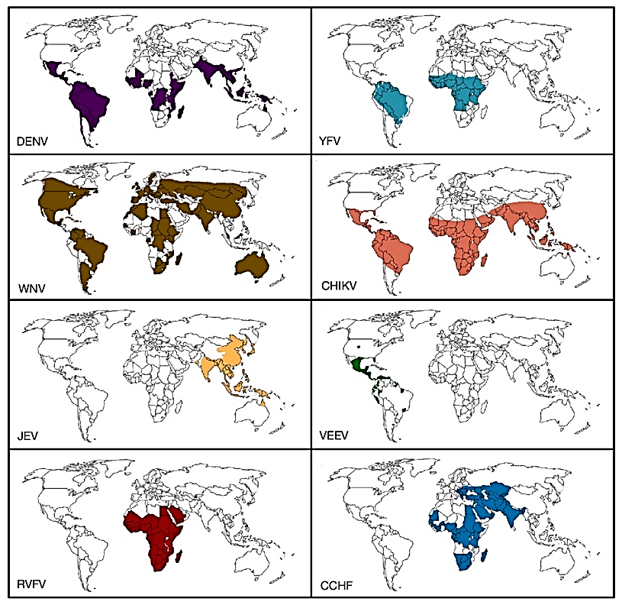
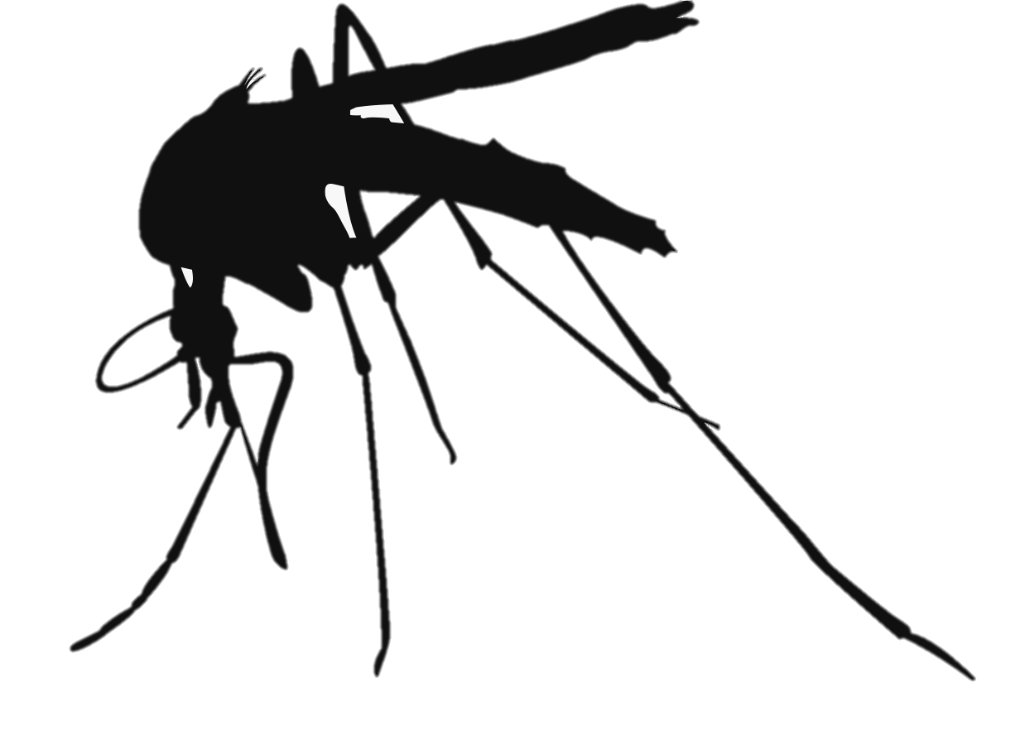
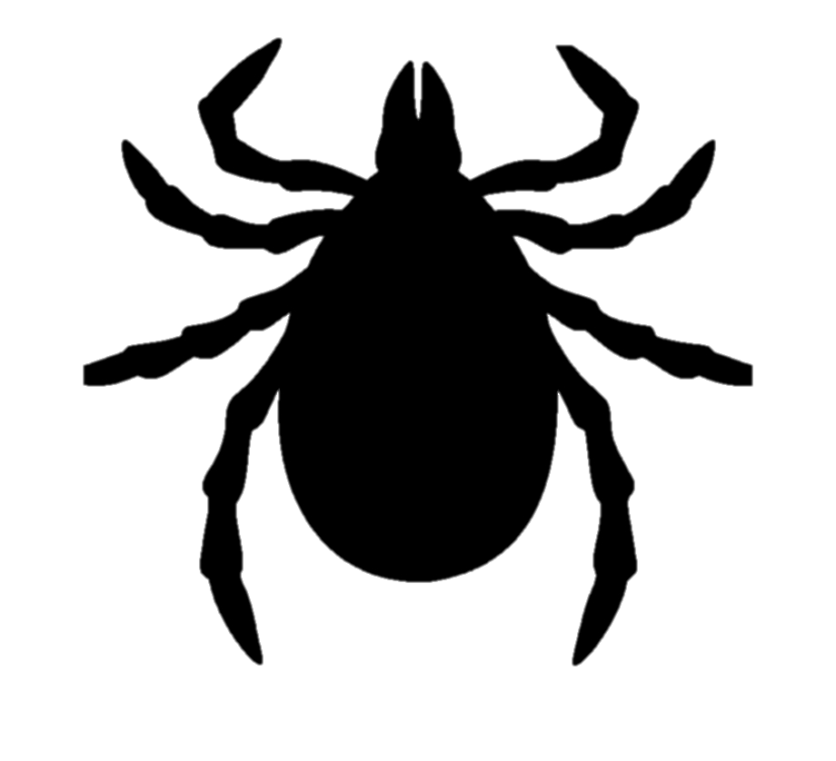
Important arbovirus distributions
Dengue virus
Yellow fever virus
Aedes spp.
Aedes spp.
West Nile virus
Chikungunya virus
Culex pipiens
Aedes spp.
Japanese encephalitisvirus
Venezuelan equine encephalitis virus
Culex pipiens
Culex -> Aedes
Crimean-Congo hemorrhagic fever virus
Rift-Valley fever virus
Culex and Aedes
Hyalomma ticks
Iranpour. 2016. Expert Reviews in Molecular Medicine

Slide 24
Flaviviruses
Important arbovirus distributions
Dengue virus
Yellow fever virus
Aedes spp.
Aedes spp.
West Nile virus
Chikungunya virus
Culex pipiens
Aedes spp.
Japanese encephalitisvirus
Venezuelan equine encephalitis virus
Culex pipiens
Culex -> Aedes
Crimean-Congo hemorrhagic fever virus
Rift-Valley fever virus
Culex and Aedes
Hyalomma ticks
Iranpour. 2016. Expert Reviews in Molecular Medicine

Slide 25
Alphaviruses (Togaviridae)
Important arbovirus distributions
Dengue virus
Yellow fever virus
Aedes spp.
Aedes spp.
West Nile virus
Chikungunya virus
Culex pipiens
Aedes spp.
Japanese encephalitisvirus
Venezuelan equine encephalitis virus
Culex pipiens
Culex -> Aedes
Crimean-Congo hemorrhagic fever virus
Rift-Valley fever virus
Culex and Aedes
Hyalomma ticks
Iranpour. 2016. Expert Reviews in Molecular Medicine

Slide 26
Bunyaviruses
Important arbovirus distributions
Dengue virus
Yellow fever virus
Aedes spp.
Aedes spp.
West Nile virus
Chikungunya virus
Culex pipiens
Aedes spp.
Japanese encephalitisvirus
Venezuelan equine encephalitis virus
Culex pipiens
Culex -> Aedes
Crimean-Congo hemorrhagic fever virus
Rift-Valley fever virus
Culex and Aedes
Hyalomma ticks
Iranpour. 2016. Expert Reviews in Molecular Medicine

Slide 27
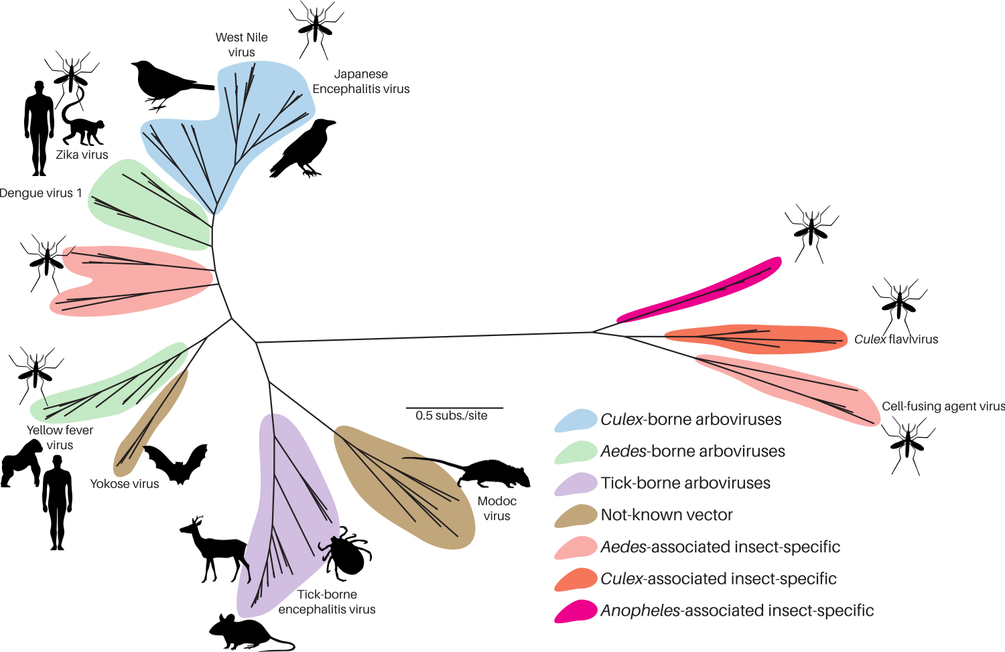
Arboviruses infect a wide range of hosts and vectors
Flavivirus viral genus phylogeny
Sebastian Lequime. 2020.

Slide 28
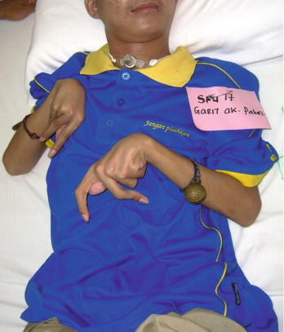
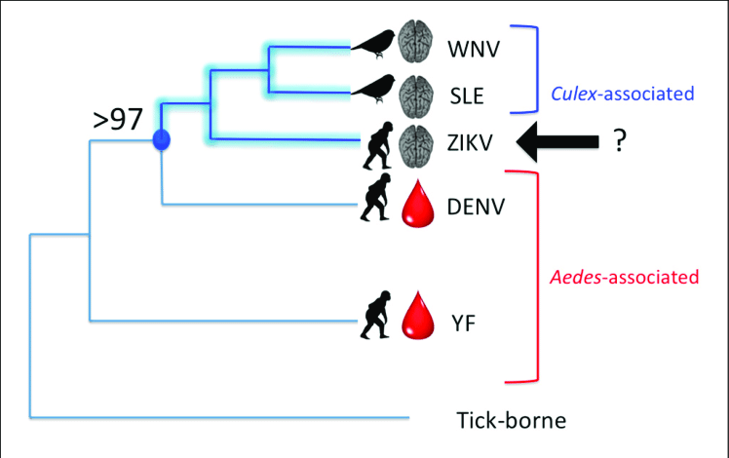
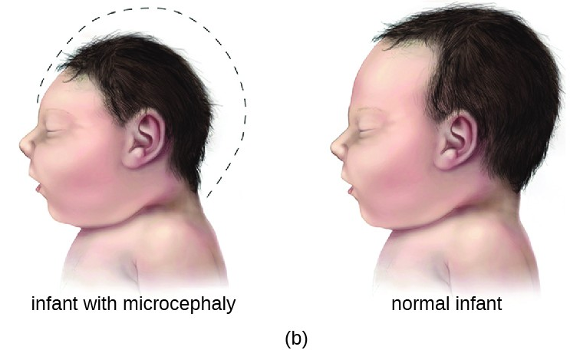
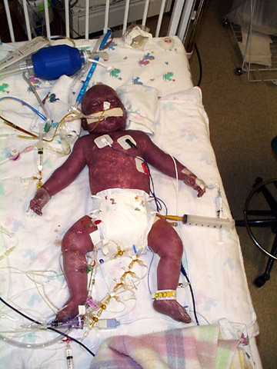
Is flavivirus pathogenesis correlated with vector identity?
Hunter. 2017. Frontiers in Micro
Notes:
Flaviviruses are among themselves diverse. They group by transmission, tick-borne, mosquito-borne, no –known vector, or insect specific (meaning they are transmitted between insects). They have a wide range of clinical manifestations such as hemorrhagic fever, encephalitis, paralysis, chronic arthraligia and more recently ZIKV has been shown to cause birth defects such as microcephaly. Importantly, most flaviviruses, are zoonotic and emerged into the human population from wildlife cycles the best example of which is Dengue virus.

Slide 29
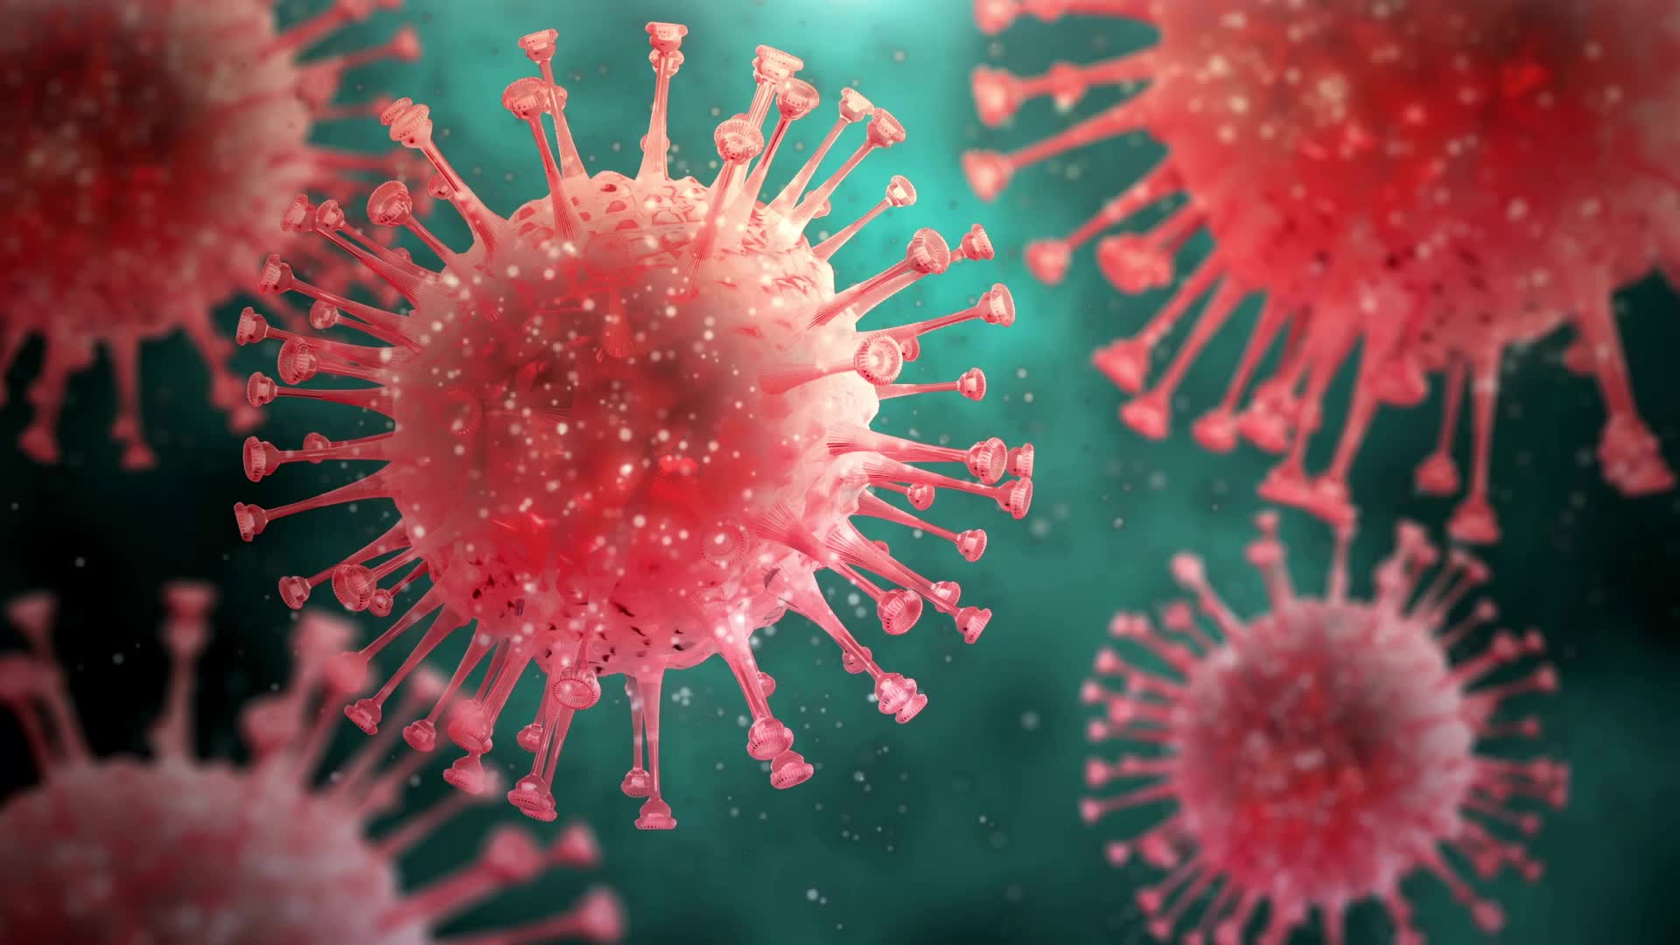
A brief introduction to dengue.
Notes:
I’ll start with a brief introdcuction to dengue

Slide 30
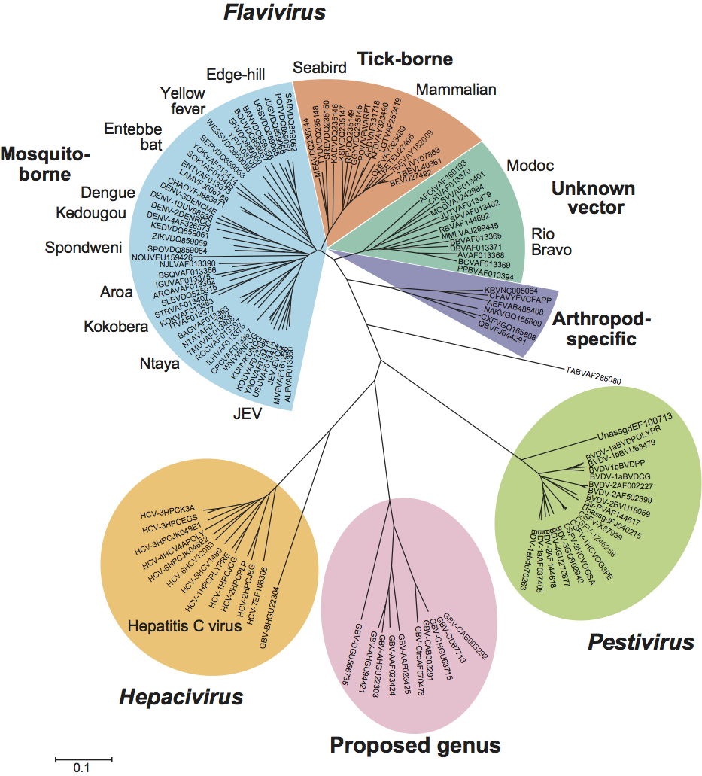
A brief introduction to dengue.
Dengue is an arbovirus disease caused by one of four known serotypes of dengue flavivirus (DENV-1, -2,-3,-4).
DENV is vectored by mosquitoes in the genus Aedes.
Zika
ICTV (ictv.global/)
WHO 2012
Notes:
Dengue is an arbovirus disease caused by one of four known serotypes of dengue flavivirus (DENV-1, -2,-3,-4).
DENV is vectored by mosquitoes in the genus Aedes.

Slide 31
A brief introduction to dengue.
Dengue is an arbovirus disease caused by one of four known serotypes of dengue flavivirus (DENV-1, -2,-3,-4).
DENV is vectored by mosquitoes in the genus Aedes.
40% of the world’s population resides in dengue-endemic regions, though historically the burden has been highest in Southeast Asia.
WHO 2012
Notes:
40% of the word’s population resides in dengue-endemic regions, though historically the burden has been highest in Southeast Asia.

Slide 32
A brief introduction to dengue.
Dengue is an arbovirus disease caused by one of four known serotypes of dengue flavivirus (DENV-1, -2,-3,-4).
DENV is vectored by mosquitoes in the genus Aedes.
40% of the world’s population resides in dengue-endemic regions, though historically the burden has been highest in Southeast Asia.
Most (70+%) of dengue cases are asymptomatic, but a small proportion develop into dengue hemorrhagic fever (DHF) or dengue shock syndrome (DSS).
WHO 2012
Notes:
Most (70+%) of dengue cases are asymptomatic, but a small proportion develop into dengue hemorrhagic fever (DHF) or dengue shock syndrome (DSS).

Slide 33
A brief introduction to dengue.
Dengue is an arbovirus disease caused by one of four known serotypes of dengue flavivirus (DENV-1, -2,-3,-4).
DENV is vectored by mosquitoes in the genus Aedes.
40% of the world’s population resides in dengue-endemic regions, though historically the burden has been highest in Southeast Asia.
Most (70+%) of dengue cases are asymptomatic, but a small proportion develop into dengue hemorrhagic fever (DHF) or dengue shock syndrome (DSS).
Most severe cases occur in secondary infections resulting from antibody-dependent enhancement (ADE), a phenomenon whereby pre-existing immunity to a single serotype facilitates infection by a subsequent serotype.
WHO 2012
Notes:
Most severe cases occur in secondary infections resulting from antibody-dependent enhancement (ADE), a phenomenon whereby pre-existing immunity to a single serotype facilitates infection by a subsequent serotype.

Slide 34
Dengue vaccines
Two licensed vaccines in circulation – both tetravalent live attenuated vaccines which confer immunity to all 4 serotypes simultaneously
Notes:
TAK-003 was tested in 28 locations distributed in: Brazil, Colombia, Dom Rep, Nicaragua, Panama, Philippines, Sri Lanka, Thailand

Slide 35
Dengue vaccines
Two licensed vaccines in circulation – both tetravalent live attenuated vaccines which confer immunity to all 4 serotypes simultaneously
Dengvaxia – by Sanofi Pasteur
First licensed in 2016 but controversy developed after severe cases developed in those who were previously naïve in Philippines
Now recommended only in those who test seropositive.
This policy has greatly diminished demand. Vaccine no longer widely used.
Notes:
TAK-003 was tested in 28 locations distributed in: Brazil, Colombia, Dom Rep, Nicaragua, Panama, Philippines, Sri Lanka, Thailand

Slide 36
Dengue vaccines
Two licensed vaccines in circulation – both tetravalent live attenuated vaccines which confer immunity to all 4 serotypes simultaneously
Dengvaxia – by Sanofi Pasteur
First licensed in 2016 but controversy developed after severe cases developed in those who were previously naïve in Philippines
Now recommended only in those who test seropositive.
This policy has greatly diminished demand. Vaccine no longer widely used.
Qdenga – TAK-003 – by Takeda
Pre-qualified for use in May 2024
Appears to be efficacious in both seronegative/seropositive individuals, though is ineffective at preventing infection for DENV-3/4 in seronegatives and lack of enhanced pathogenicity cannot be ruled out.
WHO recommends use in children 6-16 in high transmission settings only at this stage.
Notes:
TAK-003 was tested in 28 locations distributed in: Brazil, Colombia, Dom Rep, Nicaragua, Panama, Philippines, Sri Lanka, Thailand

Slide 37
Dengue vaccines
Two licensed vaccines in circulation – both tetravalent live attenuated vaccines which confer immunity to all 4 serotypes simultaneously
Dengvaxia – by Sanofi Pasteur
First licensed in 2016 but controversy developed after severe cases developed in those who were previously naïve in Philippines
Now recommended only in those who test seropositive
This policy has greatly diminished demand. Vaccine no longer widely used.
Qdenga – TAK-003 – by Takeda
Pre-qualified for use in May 2024
Appears to be efficacious in both seronegative/seropositive individuals, though is ineffective at preventing infection for DENV-3/4 in seronegatives and lack of enhanced pathogenicity cannot be ruled out.
WHO recommends use in children 6-16 in high transmission settings only at this stage.
NIH NIAID vaccine TV005 also showing promise but not yet licensed.
Notes:
TAK-003 was tested in 28 locations distributed in: Brazil, Colombia, Dom Rep, Nicaragua, Panama, Philippines, Sri Lanka, Thailand

Slide 38
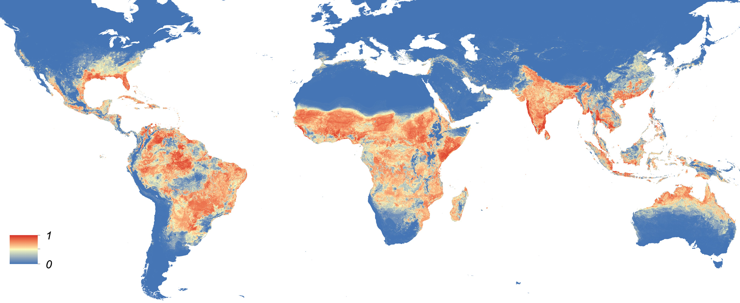
Global distribution of Aedes aegypti
Kraemer et al. 2015

Slide 39
Global distribution of Aedes albopictus
Kraemer et al. 2015

Slide 40
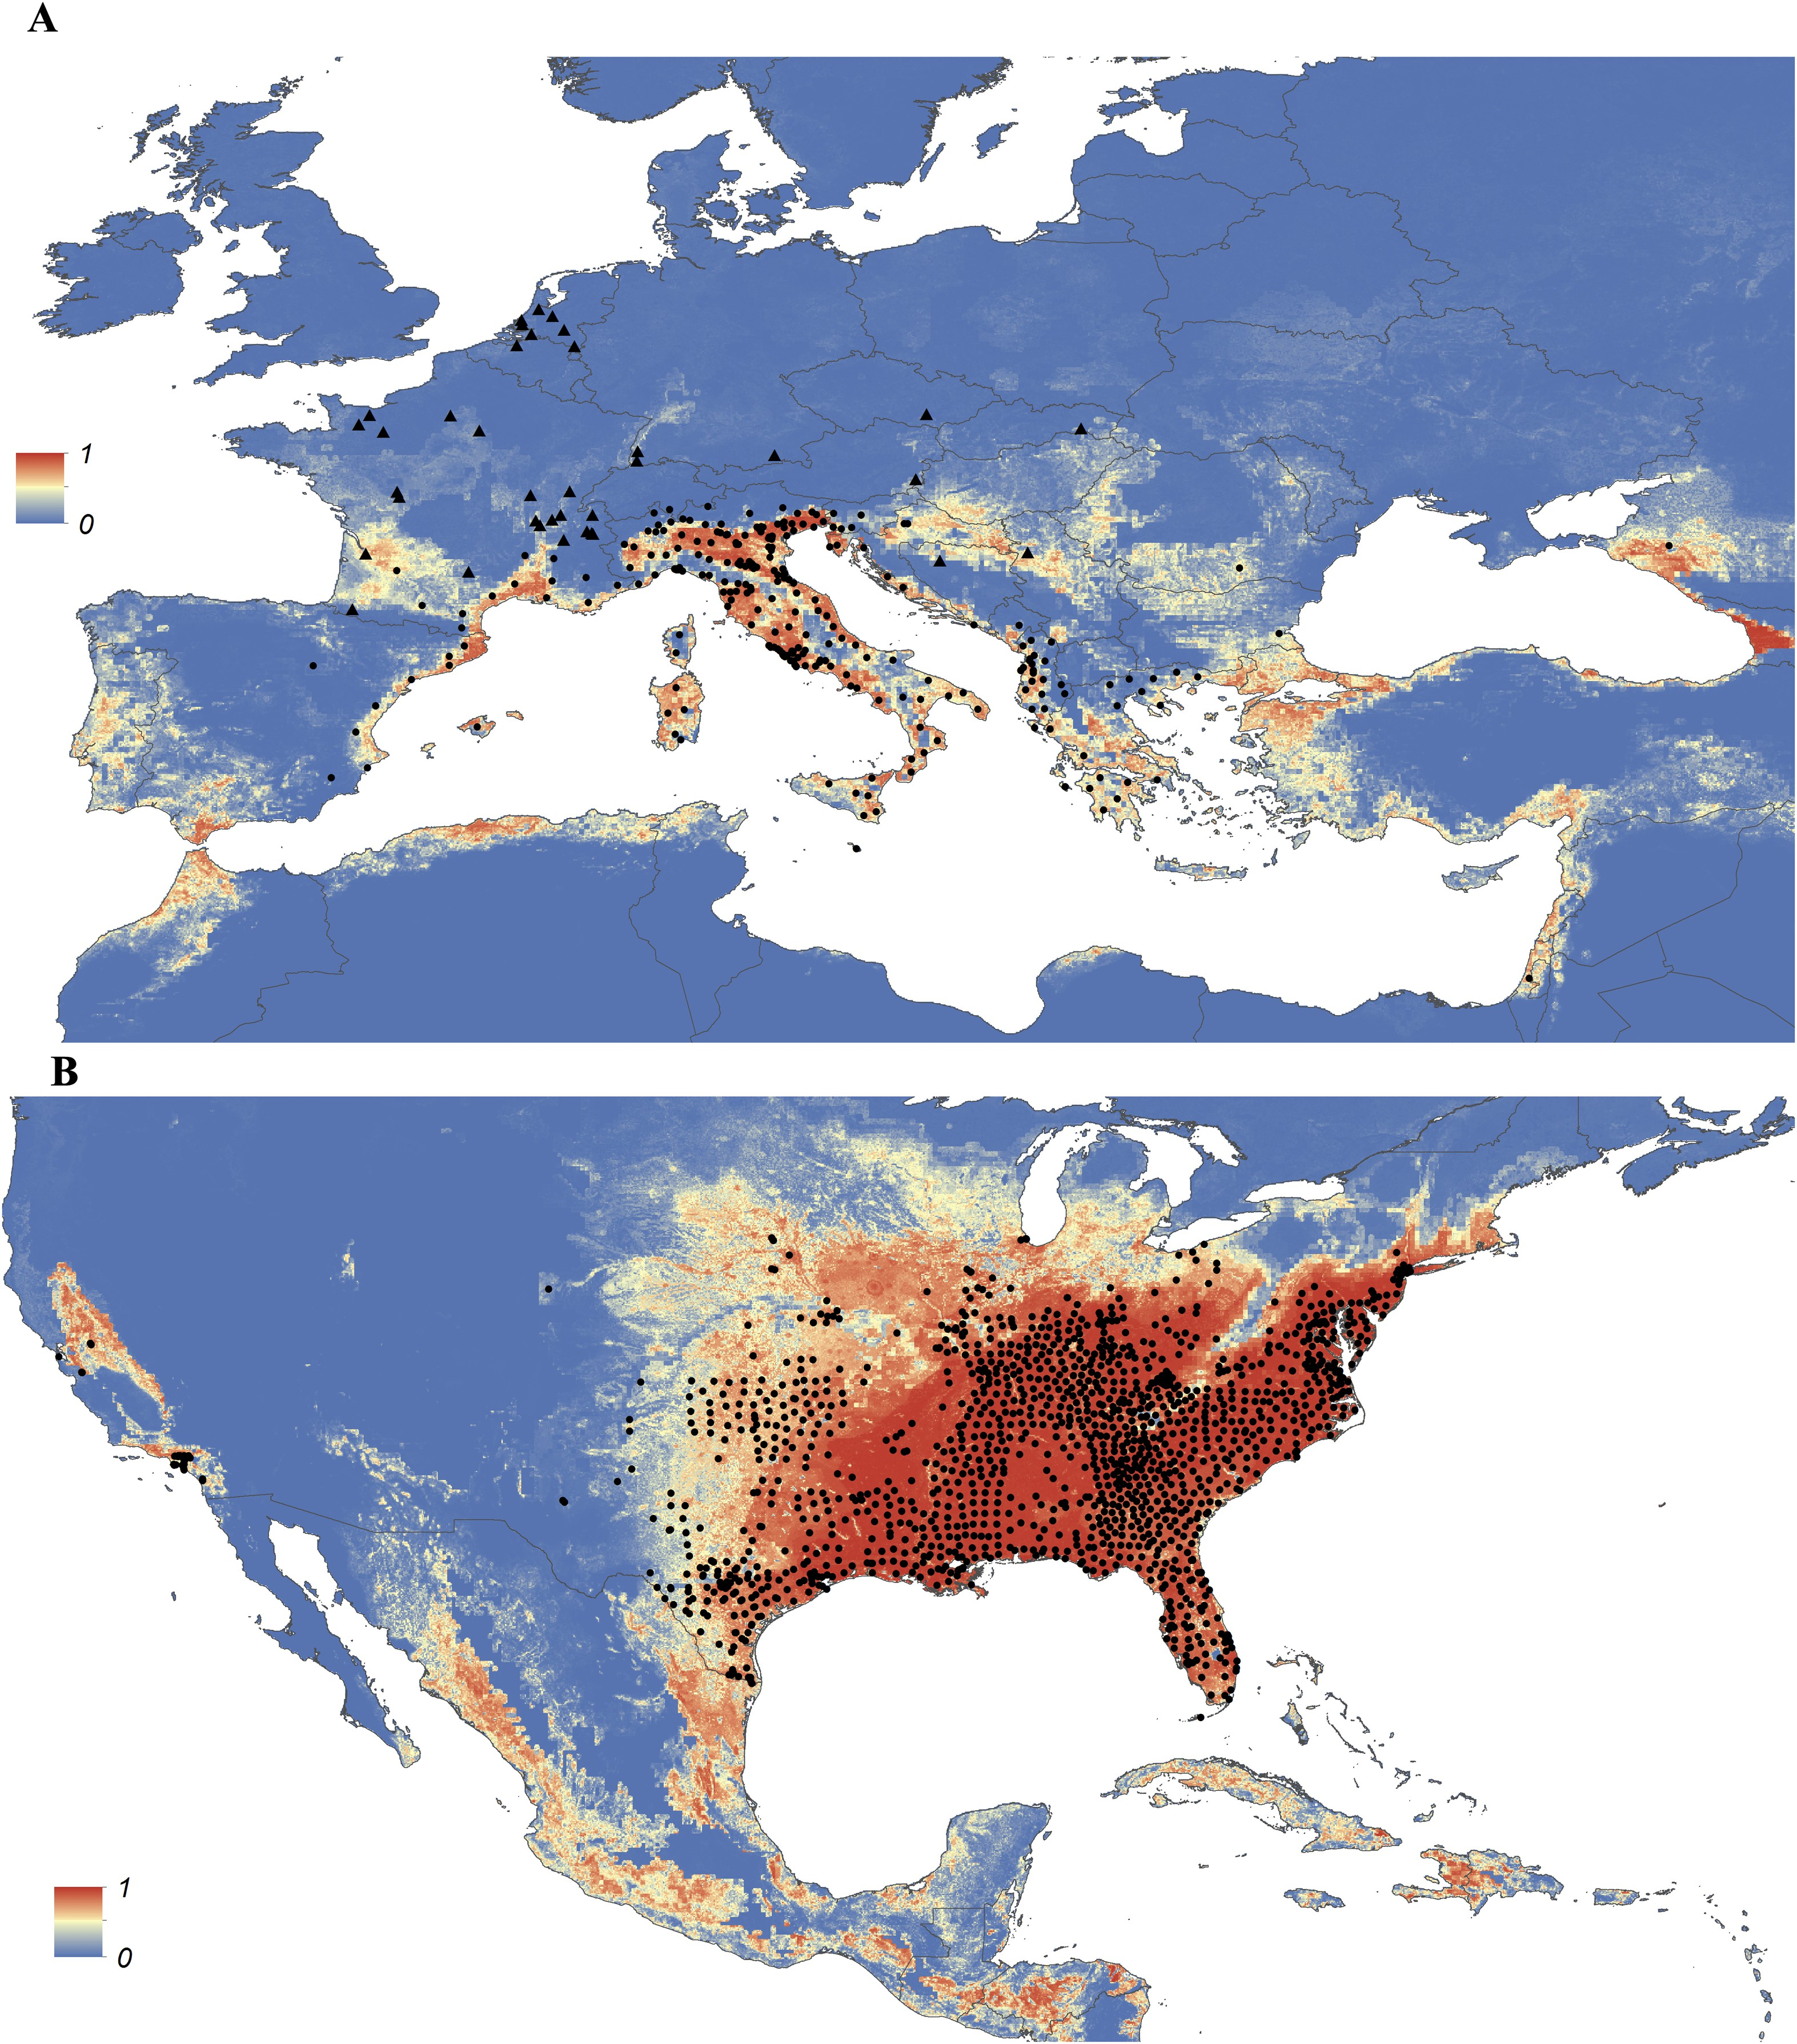
Detailed probability of occurrence of Aedes albopictus in Europe and US, areas where the mosquito is most rapidly expanding its range
Kraemer et al. 2015

Slide 41
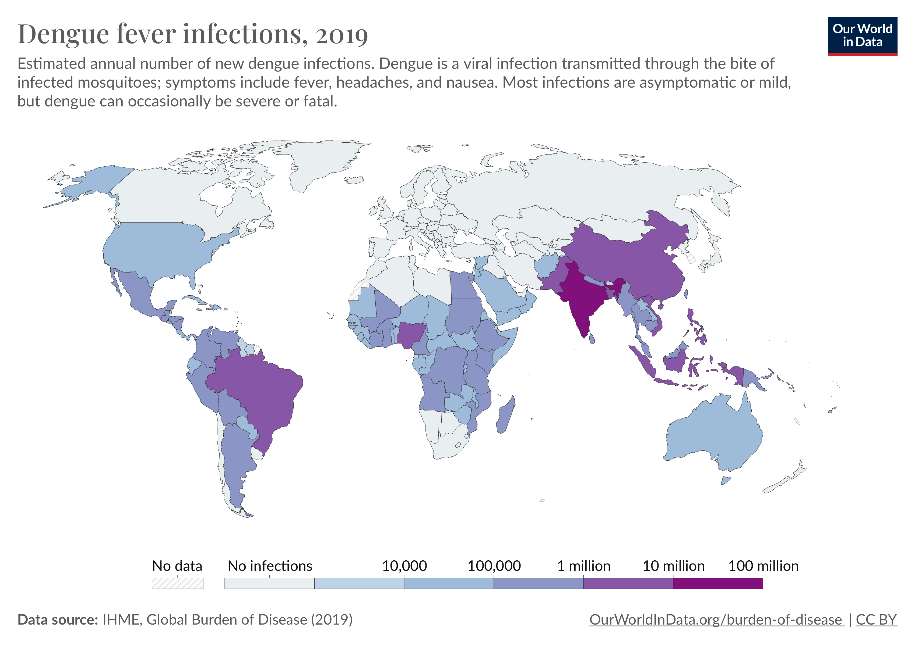

Slide 42
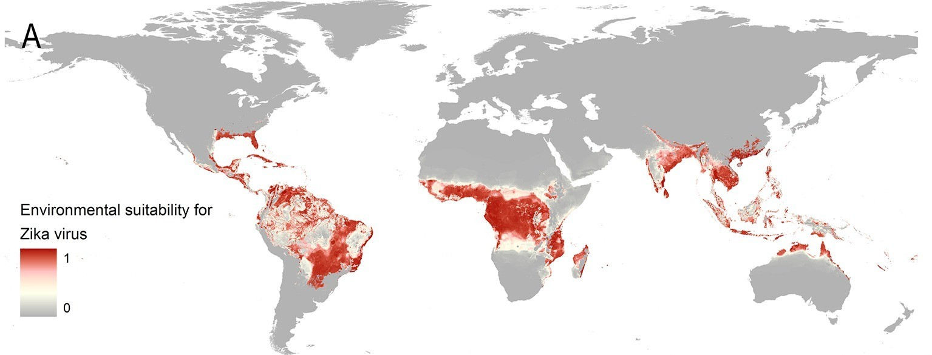
Zika is also vectored by Aedes aeygpti and its relatives
Messina et al 2016. eLife

Slide 43
Arboviruses and climate change

Slide 44
Arboviruses and climate change
Mosquito development rates are highly sensitive to temperature.
As a result, many arboviruses are climate-constrained in distribution but ranges are expanding with climate change.

Slide 45
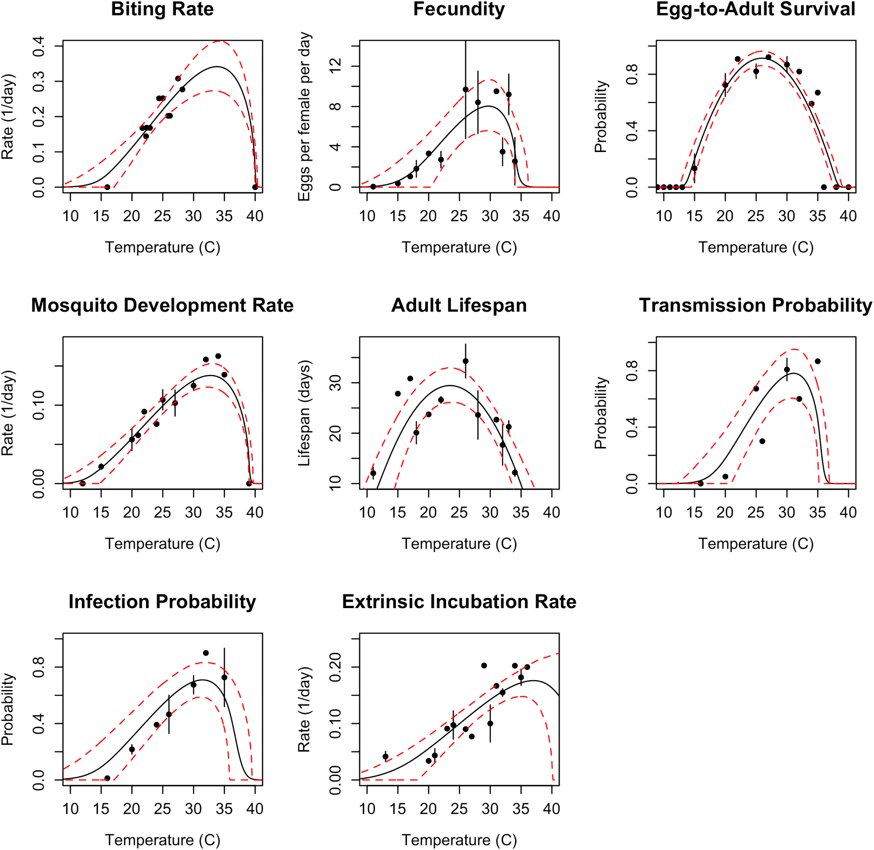
Thermal performance curves for Aedes aegypti
Mordecai et al 2017. PLoS NTDs.

Slide 46
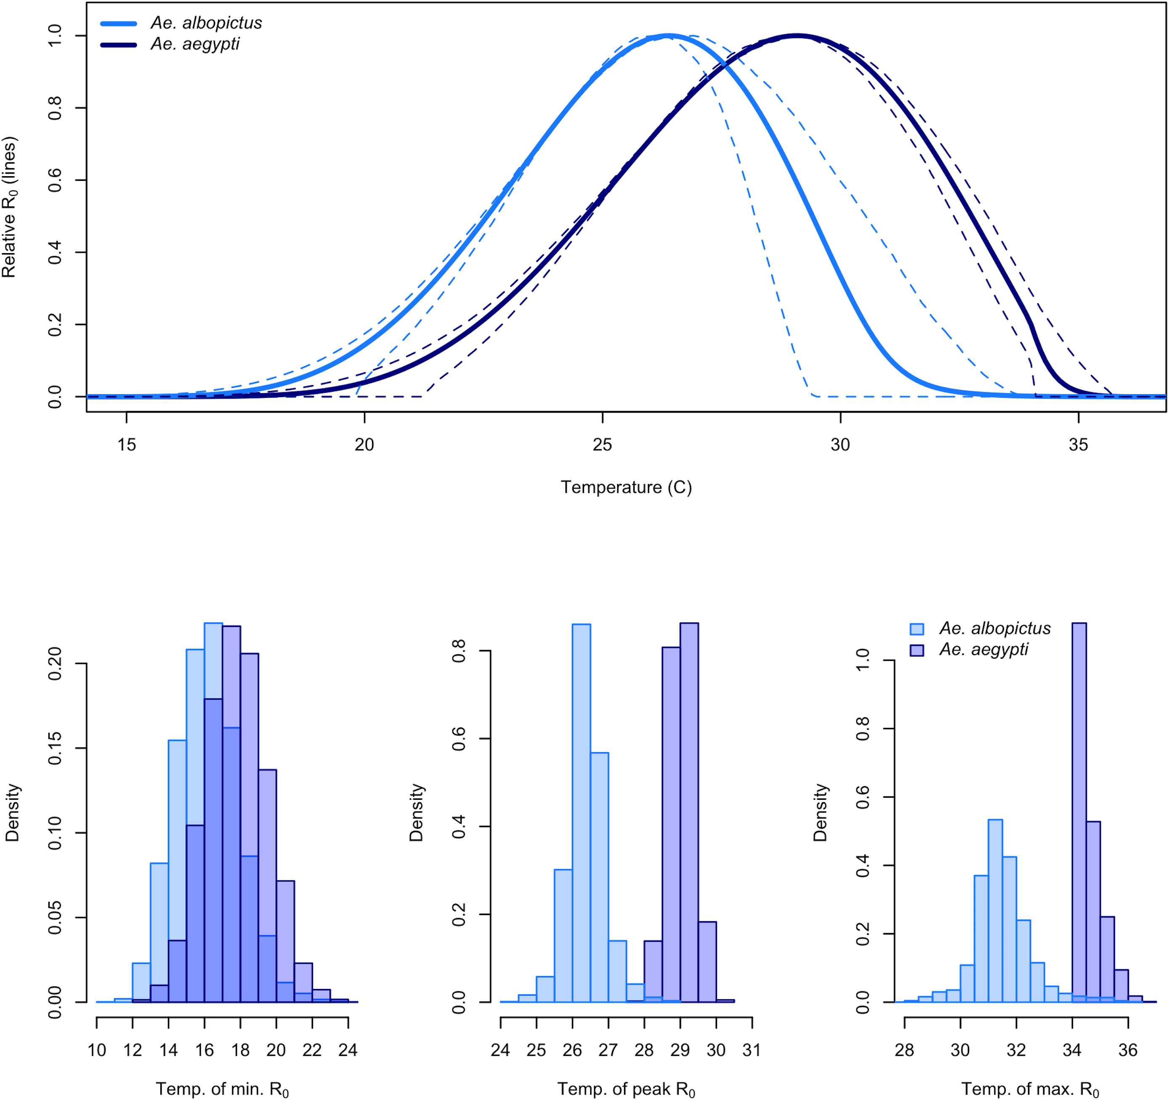
Different vectors respond to temperature in different ways.
Mordecai et al 2017. PLoS NTDs.

Slide 47
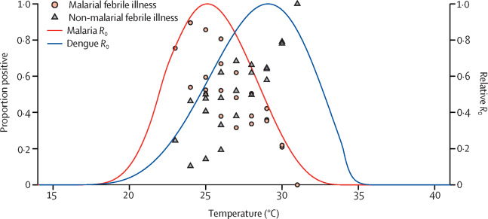
These vector differences have important consequences for disease dynamics.
Mordecai et al 2020. The Lancet Planetary Health.

Slide 48
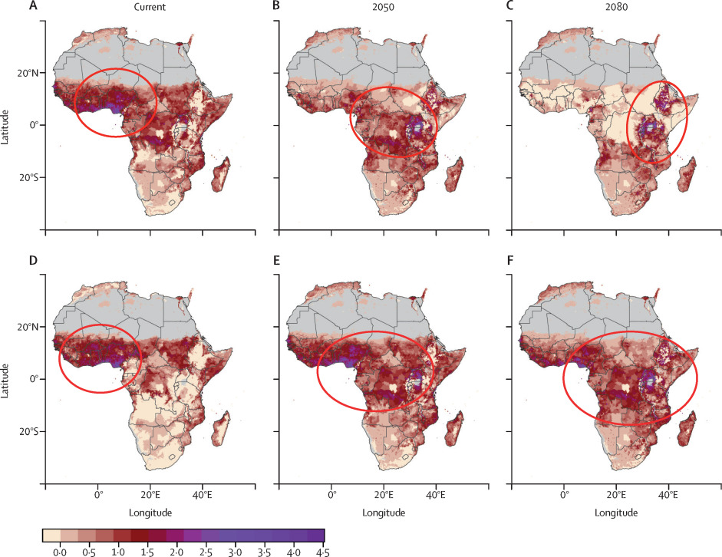
These vector differences have important consequences for disease dynamics.
malaria
dengue
Mordecai et al 2020. The Lancet Planetary Health.

Slide 49
Pathogens exhibit diverse transmission mechanisms that require tailored modeling structures
Vector-borne diseases (a type of indirect transmission) are transmitted via blood-feeding arthropod (mosquitoes, ticks, fleas)
Malaria: Mosquito-borne protozoan Plasmodium spp.
“Arboviruses”: Mosquito-borne viruses, including Dengue, Zika, Yellow fever virus, West Nile virus, Chikungunya virus
Sleeping sickness, also known as African trypanosomiasis: tsetse fly vector and protozoan pathogen (trypanosome)
Chagas disease: kissing bug vector and trypanosome pathogen
Plague: flea vector and bacterial pathogen (Yersinia pestis)
Notes:
Kissing bugs = hemiptera = true bugs

Slide 50
Pathogens exhibit diverse transmission mechanisms that require tailored modeling structures
Vector-borne diseases (a type of indirect transmission) are transmitted via blood-feeding arthropod (mosquitoes, ticks, fleas)
Malaria: Mosquito-borne protozoan Plasmodium spp.
“Arboviruses”: Mosquito-borne viruses, including Dengue, Zika, Yellow fever virus, West Nile virus, Chikungunya virus
Sleeping sickness, also known as African trypanosomiasis: tsetse fly vector and protozoan pathogen (trypanosome)
Chagas disease: kissing bug vector and trypanosome pathogen
Plague: flea vector and bacterial pathogen (Yersinia pestis)
Plague is BOTH vector-borne and zoonotic!
Notes:
Kissing bugs = hemiptera = true bugs

